Slide 1

Haldia institute of technology
Project on : IOT IV bag
monitoring & alert system.
Final Year Project

Slide 2
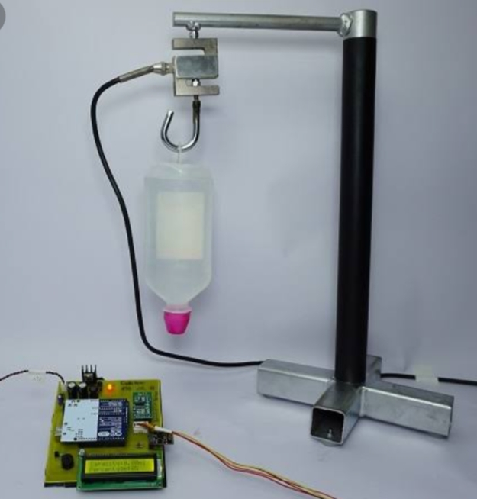
ABOUT PROJECT
➔We are working on project “IOT INTRAVEOUS FLUID MONITORING AND ALERTING”.
Once the system detects that the IV bottle has been empty it seems an alert over IOT..

Slide 3
PROBLEM
Ratio gap
COSTS
Patient ratio is high and nurse ratio is low.
Existing monitoring device costs high
Regularly monitoring
USABILITY
Customers want something easy to use that helps make their life easier
IV drips need to be regularly monitored and replaced.

Slide 4
SOLUTION
Key points
COST SAVINGS
Data can be access easily
Its work without internet also.
Low cost compared to other device.
monitoring
EASY TO USE
No need any staff for regularly monitoring.
Simple design that gives customers the targeted information they need.

Slide 5
components
➔ESP32
➔Weight sensor (load cell)
➔ESP8266
➔IV bag stand
➔Hooks
➔LCD Display (20x4)
➔Lio-battery
➔Charging module
➔Resistor
➔Capacitor
➔Voltage regulator 7805
➔IR led and Photo detector
➔SPST switch/push button
➔OPAMP LM385
5

Slide 6
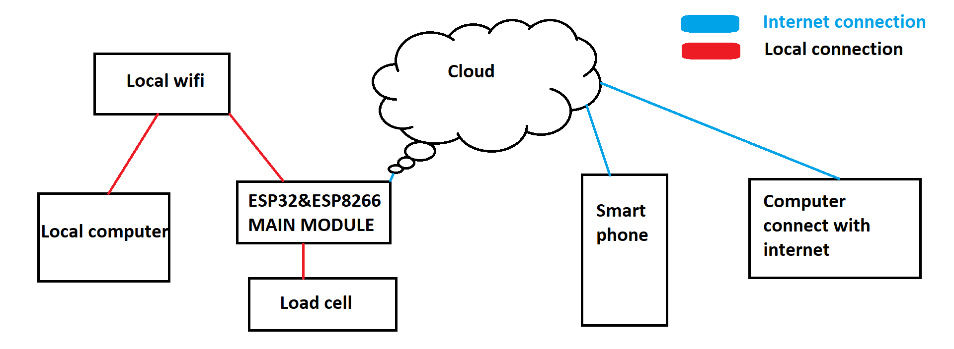
Working BLOCK DIAGRAM

Slide 7
circuit BLOCK DIAGRAM
Charging Module
Battery
Button
ESP 32
Load Cell
Air Sensor
LED Display
Server
ESP 8266

Slide 8
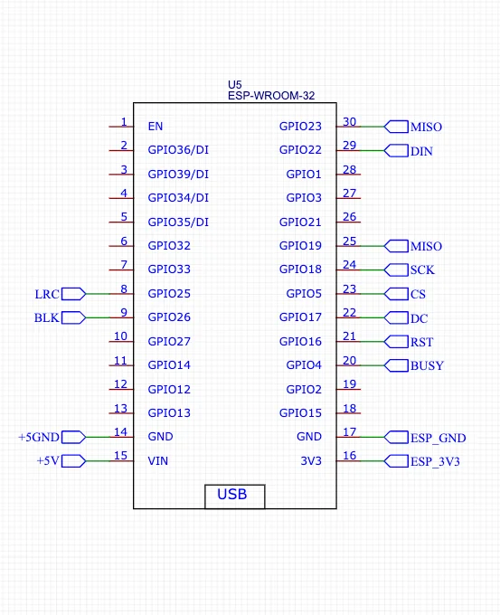
ESP 32 PIN DIAGRAM

Slide 9
PRODUCT BENEFITS
→Easy to operate.
➔Low maintanace.
➔This device works with internet or without internet

Slide 10
ADVANTAGES
→Easy to operate
→Low power consumption
→Automatic data logging
→Useful for managing large number of patients during times of crisis.
→Charging auto cutoff.

Slide 11
disadvantages
→Limited operating time.
→Limited connectivity.
→Limited battery capacity.

Slide 12
MARKET OVERVIEW
For doctors and hospitals

Slide 13
THANK YOU
Ashish Kumar Singh
Shivam Kumar
Souradip Maiti
Santanu Dey
Faiz Mohammad Danish

